Slide 1


Slide 2
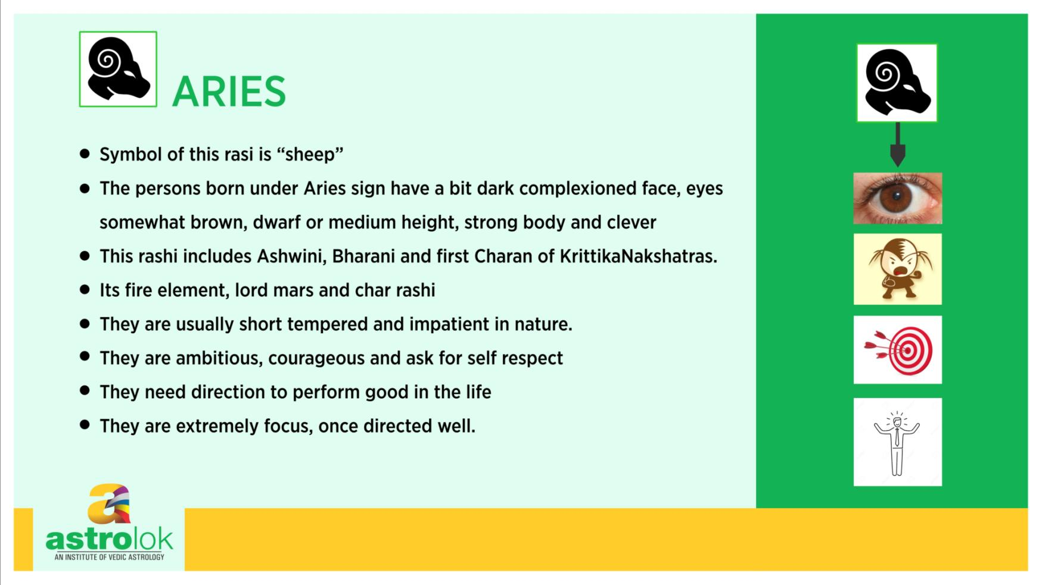

Slide 3
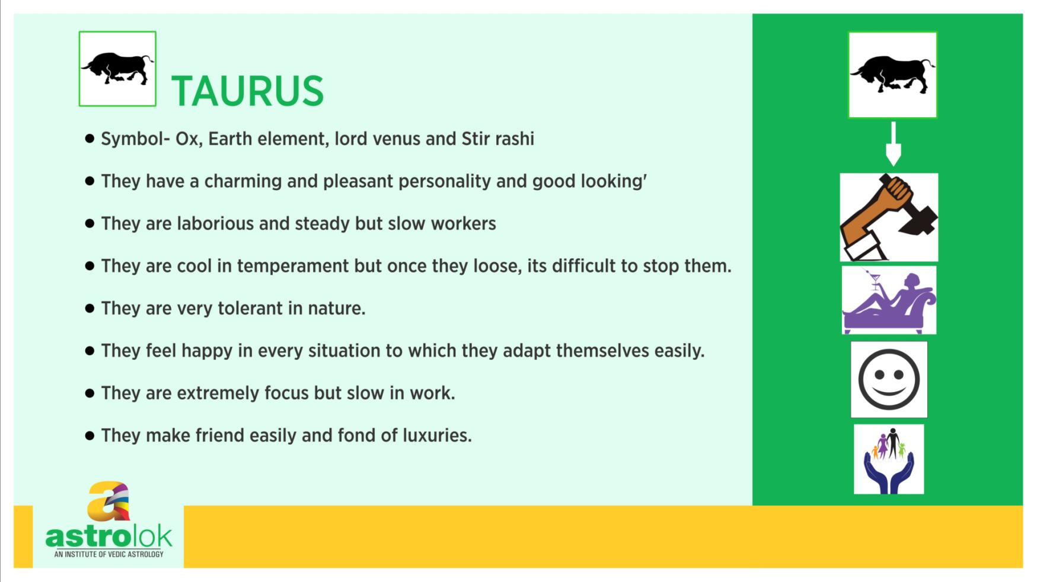

Slide 4
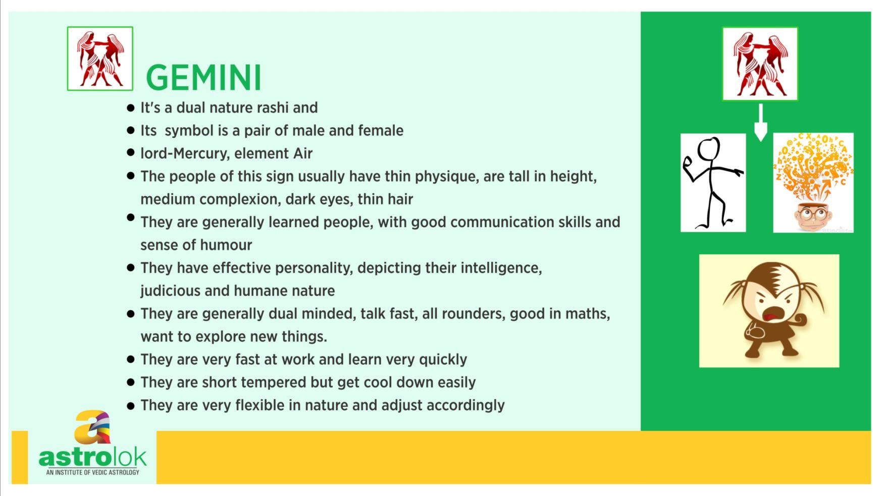

Slide 5
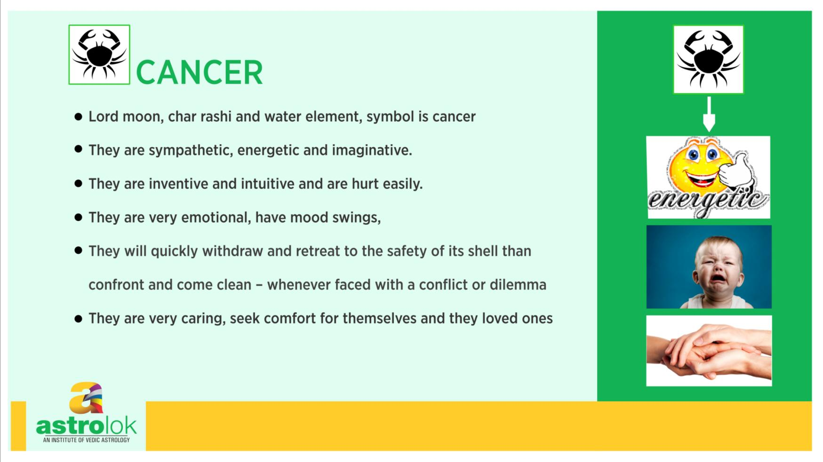

Slide 6
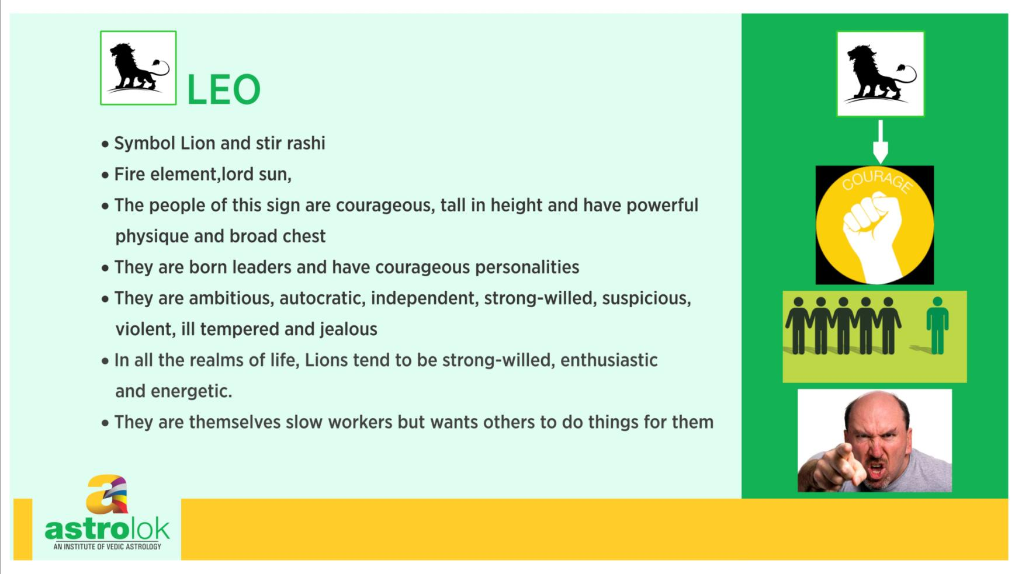

Slide 7
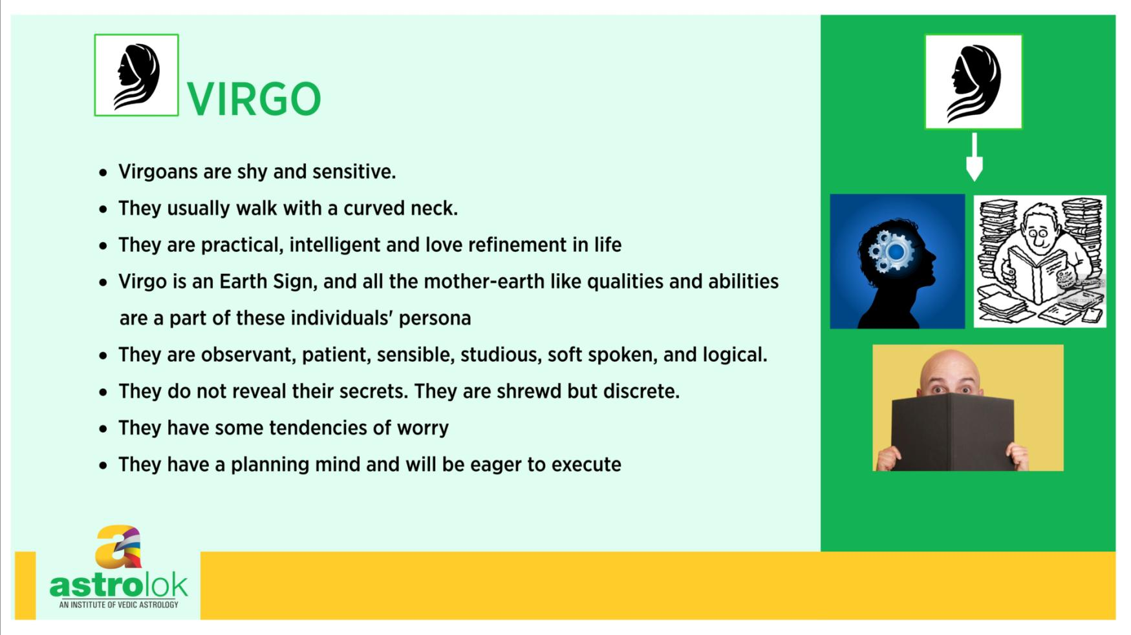

Slide 8
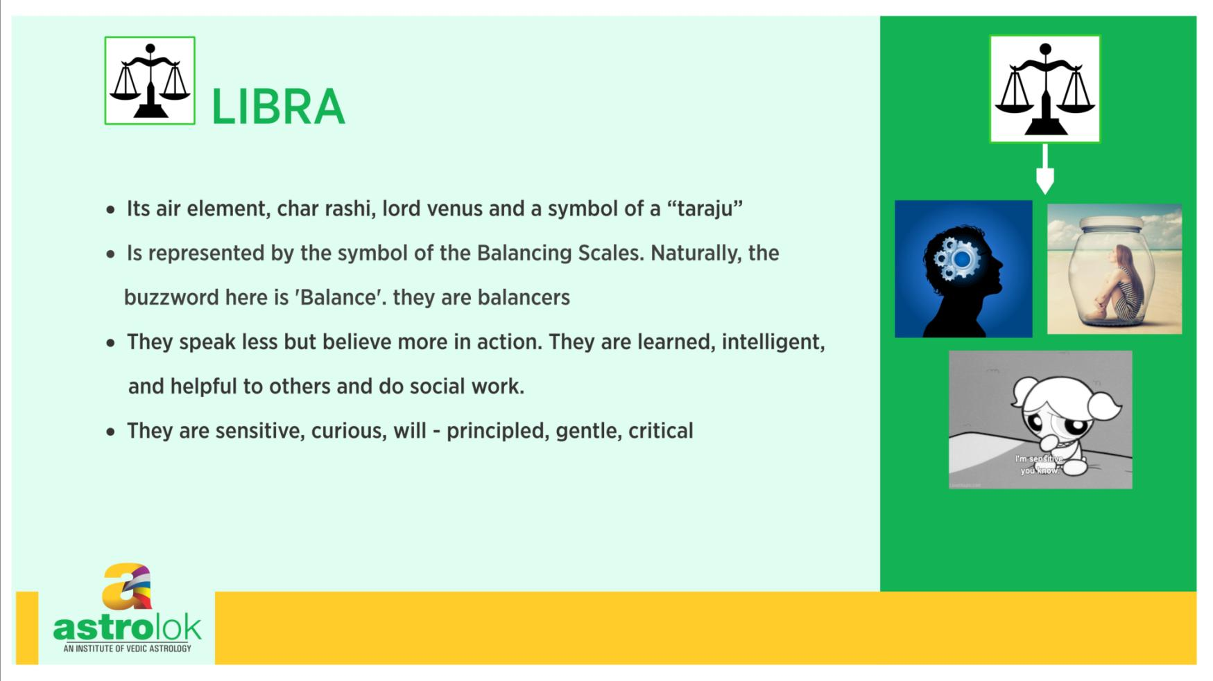

Slide 9
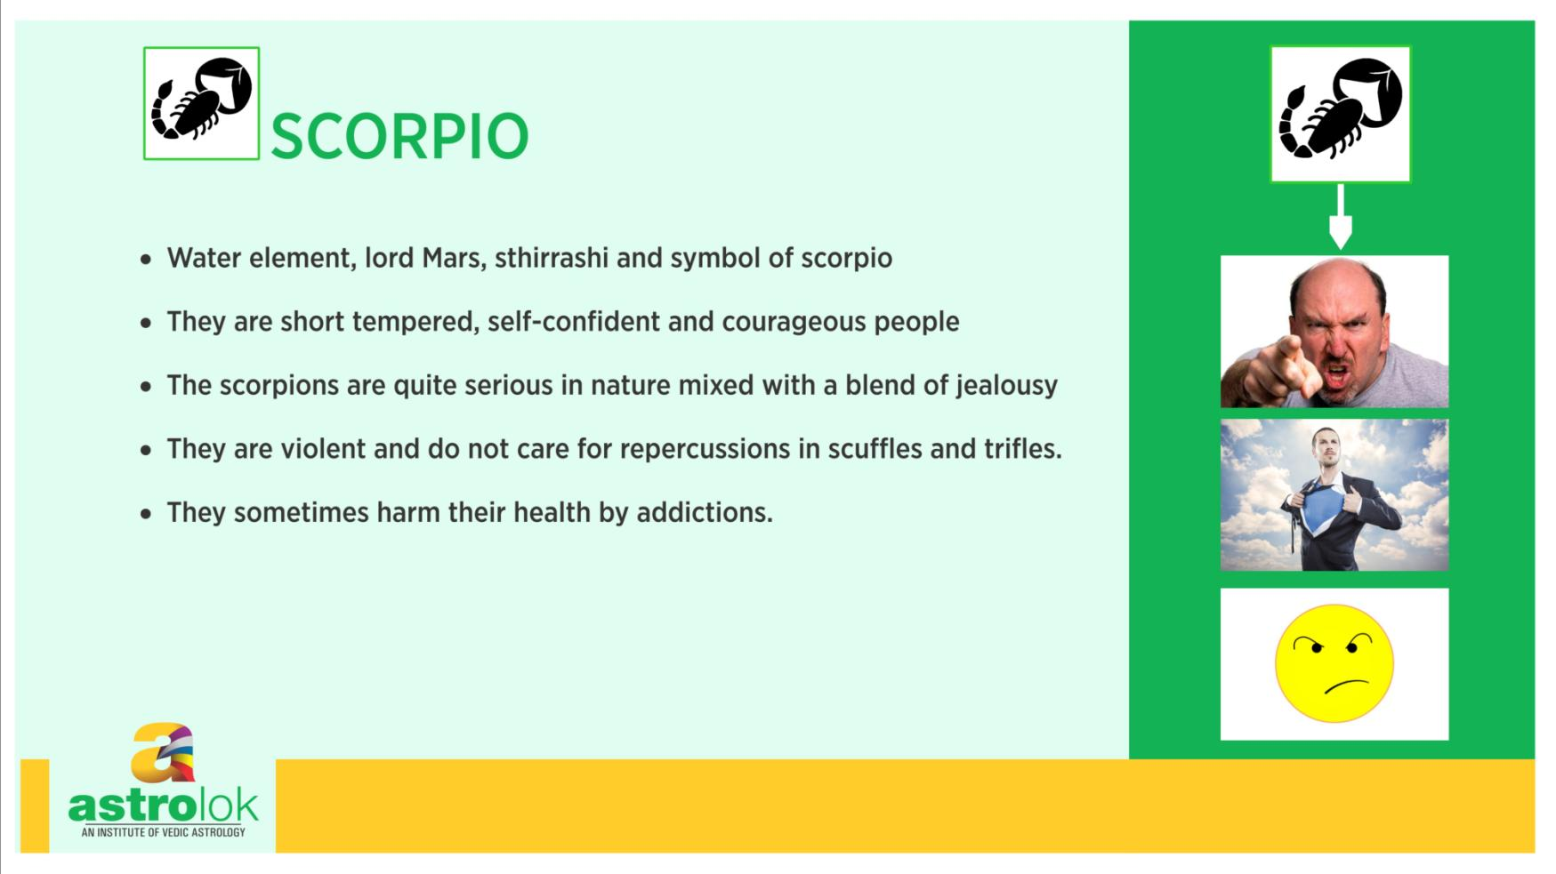

Slide 10
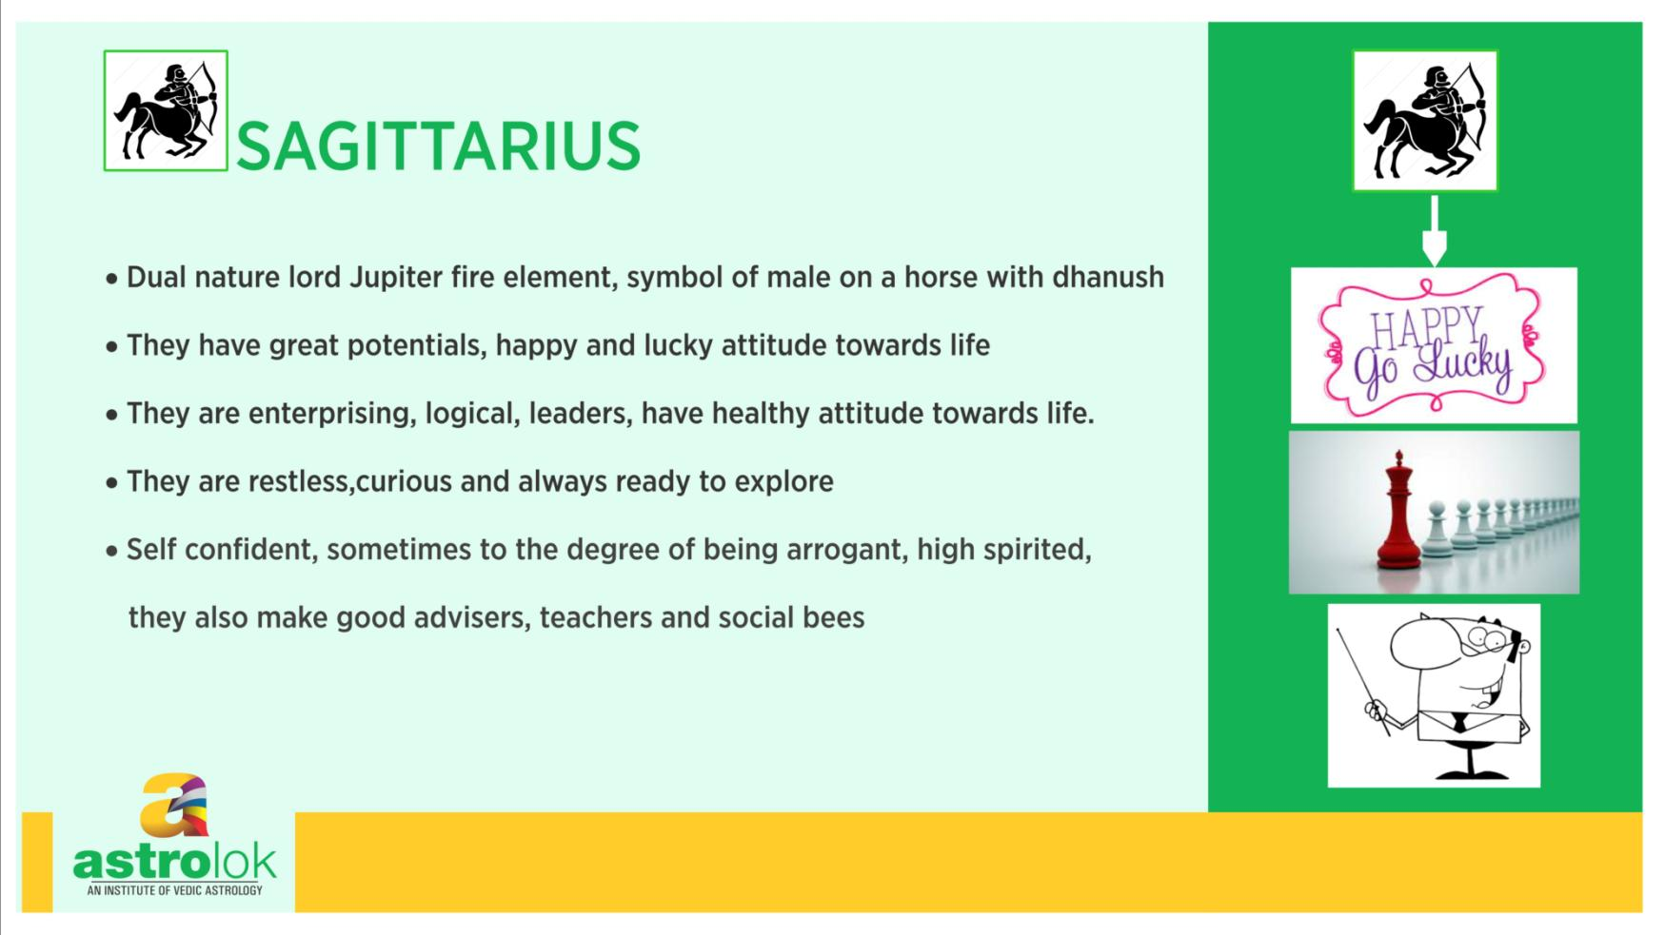

Slide 11
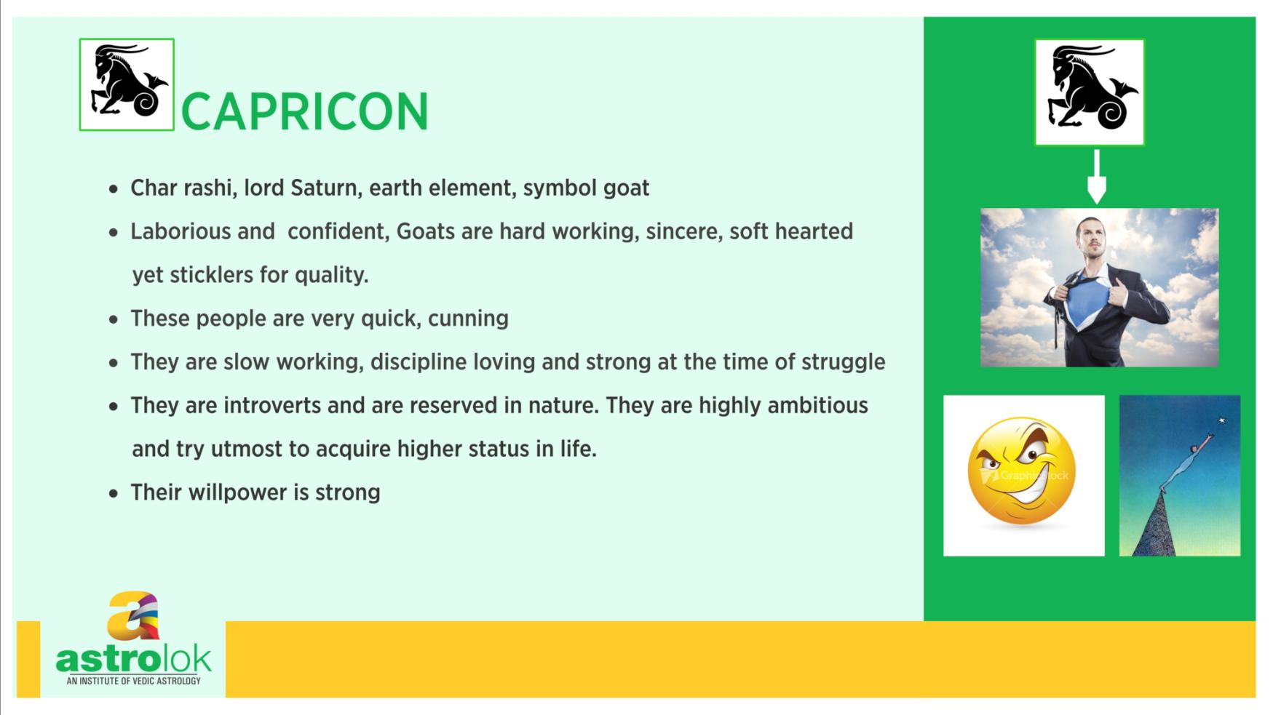

Slide 12
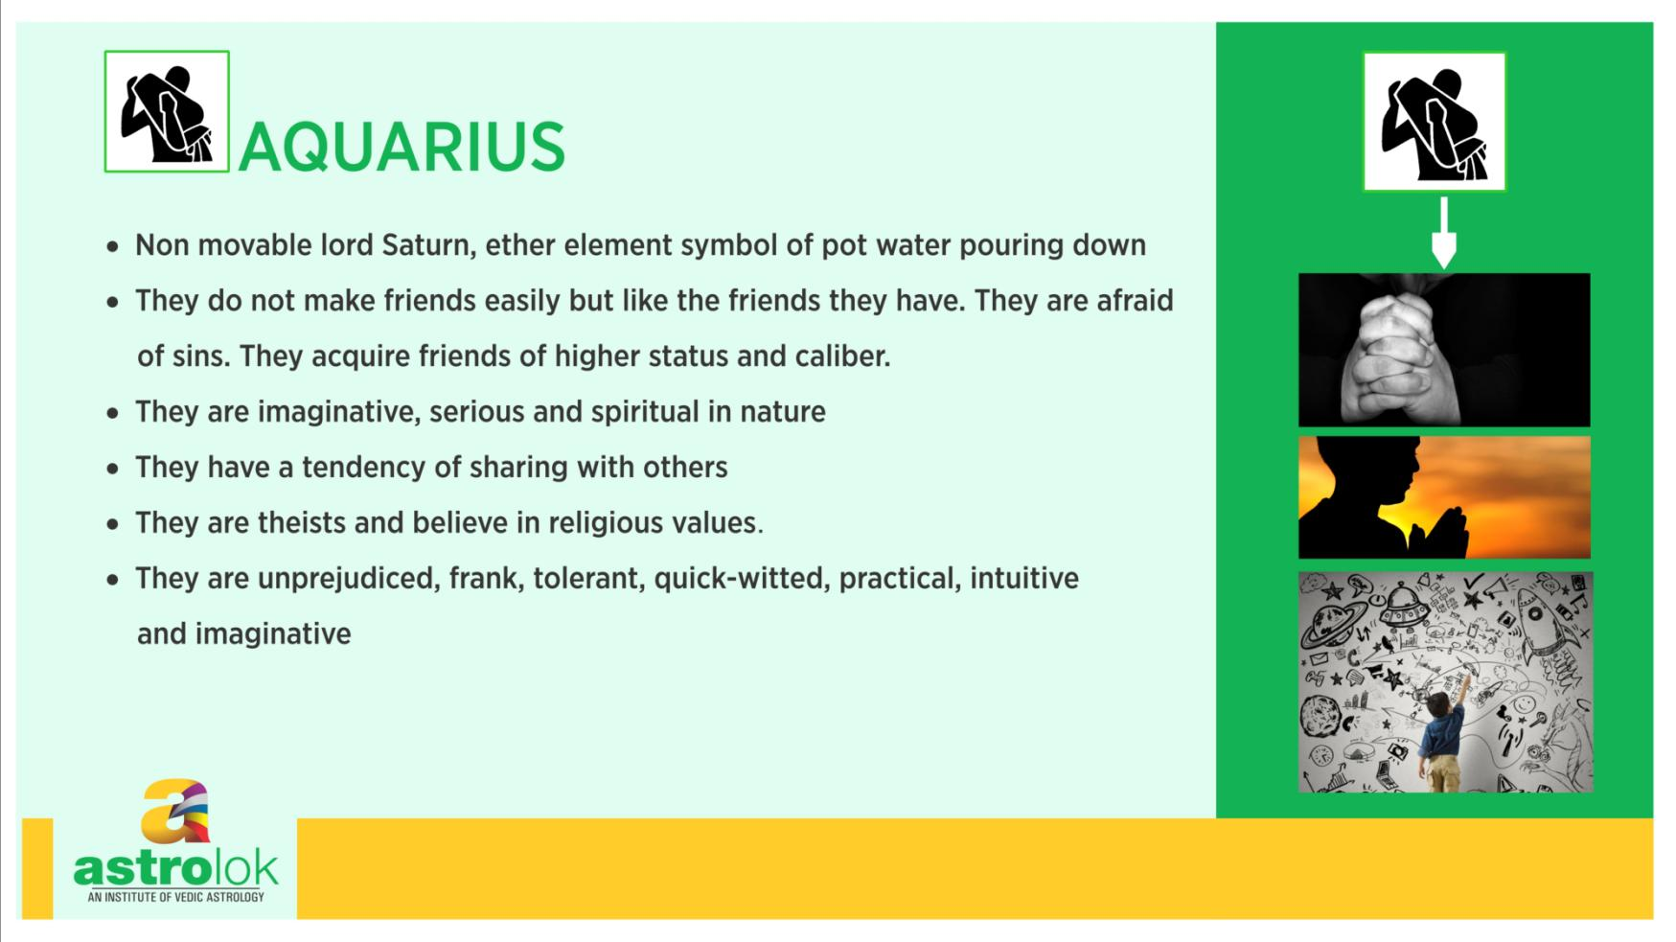

Slide 13
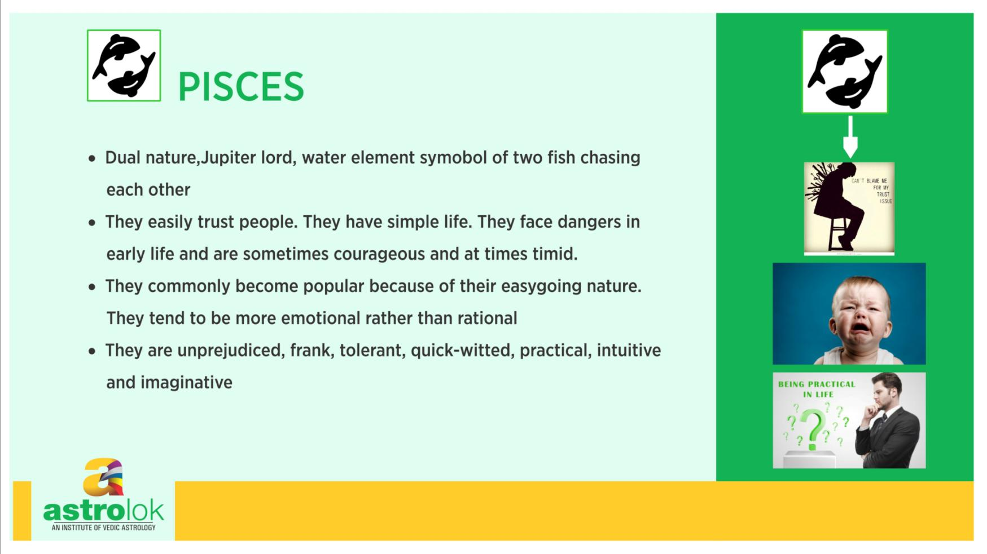

Slide 14
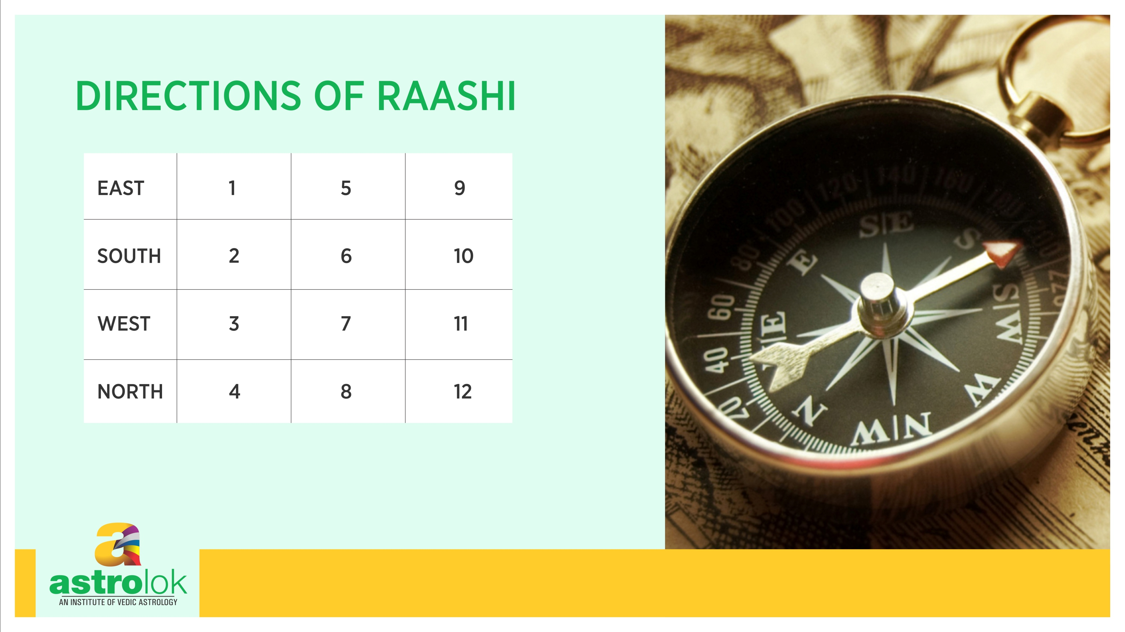

Slide 15


Slide 16
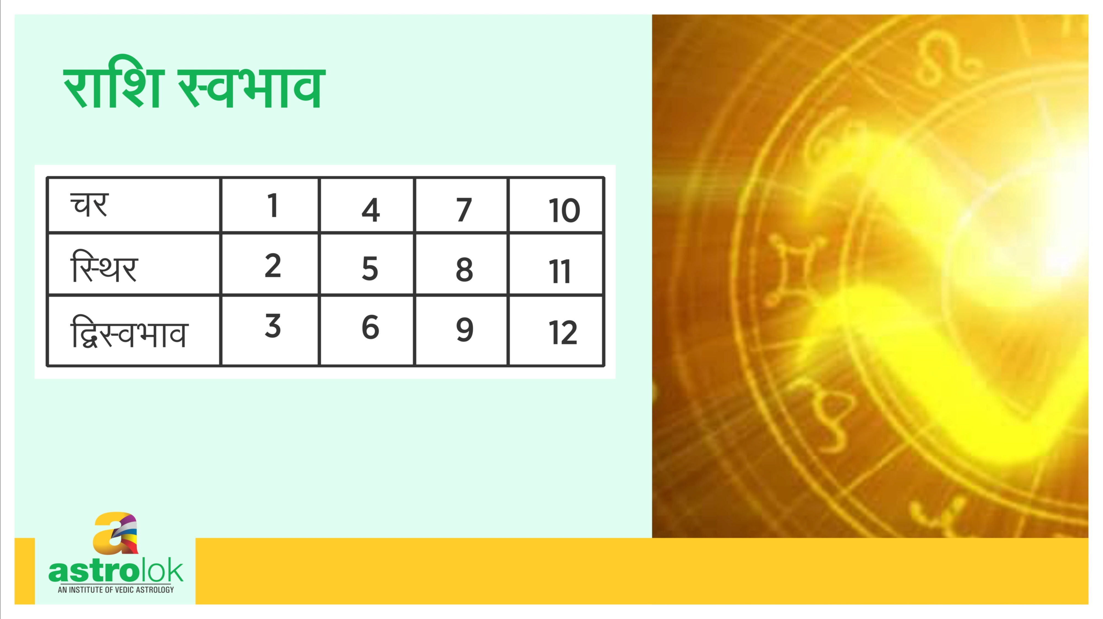

Slide 17
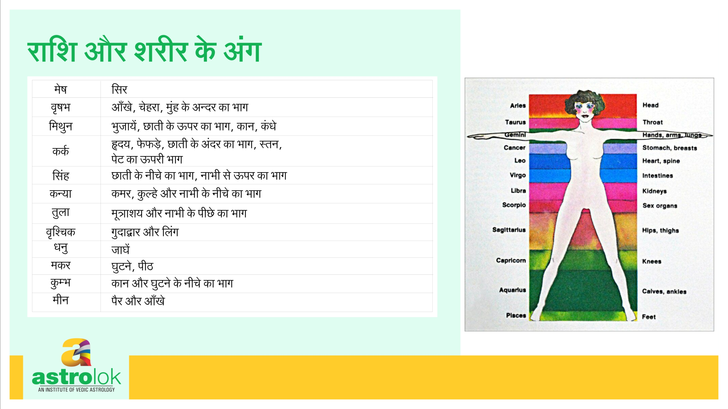

Slide 18
Rashi and their colors
Rasi | Colors | Complexion | Length
Aries | Blood Red | Reddish | Short
Taurus | White | Dark | Short
Gemini | Parrot Green | Dark | Medium
Cancer | Reddish White | Fair | Medium
Leo | Yellowish White | Reddish | Long
Virgo | Grey | Dark | Long
Libra | Black | Dark | Long
Scorpio | Yellow | Reddish | Long
Sagittarius | Golden | Fair | Medium
Capricorn | Variegated | Bluish | Medium
Aquarius | Blue/ Violet | Bluish | Short
Pisces | Fish color | Fair | Short

Slide 21
Rashi & Professions
MESHA: Govt. job, Police, Military Service, Fire Service, Sports, Engineering industry, Iron factory, boiler plant, brick chamber, pottery work, mining, surgeon, arm manufacturing, cooking, agriculture, trade union leader
VRISHABA: Jewelry business, cattle shed, money lending, commission agent, financial institutions, handicrafts, fancy articles, scented materials, five star hotels, flower merchants, fruit juice shop, drama, cinema, music, poet, story writer, singer, treasury.
MITHUNA: Information and broad casting, space dept., education dept. P & T, Telephone, book publishing , mathematics dept, accountants, auditors, law and order councilor, ambassador,
KATAKA: Export and Import, shipping, transport dept., agriculture, grocery shop, medical shop, milk booth, vegetable shop, pearl merchant, hotel business, distillery, mineral water selling,
SIMHA: Govt.Job, Politics, Administrator, Social Services, Charitable institutions, Engineering Industry
KANYA: Auditing, Accounting, Business, Teacher, writer, retail shops
TULA: Jewelry shop, fancy shop, handicrafts, perfume shop, cloth merchant, money lending, commission agents, bank, Life insurance , law dept., hotel business, bar and Restaurant, Dancing Hall, Beauty parlor, Music, Dance , Cinema
VRISCHIKA: Iron Industries, Engineering Industry, Mining, Agriculture, Electricity Dept, Metal industry, Instrument Manufacturing, precision development organization, raw materials, priest, astrology, mantra and tantra, occult practices
DHANUS: Forest dept, saw mills, wood merchant, bank, law dept, temple, financial institutions, education dept, ordnance depot, military training dept, social service, charitable institutions.
MAKARA: Hotels, food products, manure and pesticide selling, oil merchant, mining, dealing with spare parts and old articles, hardware shop, leather business, building work, Granite stone and sand business, porters, coolies, drivers, shoe polishing, shoe makers.
KUMBHA: Psychology, Astrology, Philosophy, Religion, Teaching, Research and Development, Consultancy, Administration, Oil and Natural Gas Companies, Air Service, Space Dept., Defence service, Fire Service, Jail Dept., Bomb manufacturing, tourist guide, central excise dept, butcher shop, CBI Dept.
MEENA: Education Dept, Religious Institutions, Medicine, Financial institution, Law Dept, External Affairs, Bank, Navy, shipping, temple worker, priest

